Slide 1
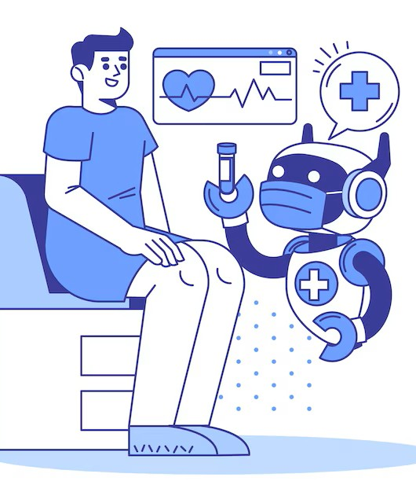
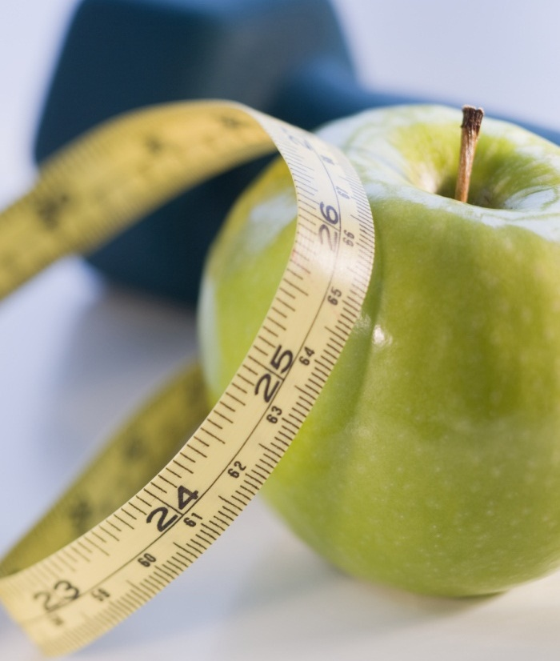

Personalized Medicine recommendation system
By – ballar Neethu kumari

Slide 2

Problem statement
Many patients self-medicate without proper knowledge, risking incorrect treatments.
Time-consuming or costly consultations delay treatment.
Need for a system to recommend suitable medicines based on symptoms.
Patients often struggle to find the right over-the-counter or prescription medicines for their symptoms without professional consultation.

Slide 3
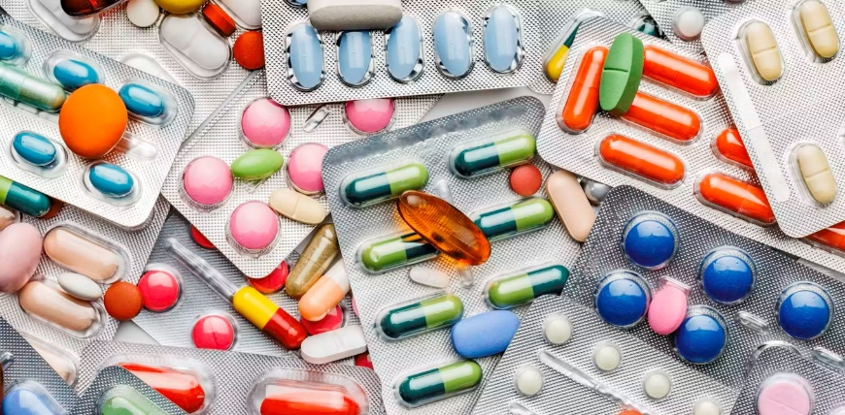
objective
Develop a system to recommend appropriate medicines using user input symptoms.
Apply machine learning to provide smart, relevant suggestions.

Slide 4

Dataset overview
Open – source symptom medicine dataset that includes 4920 rows × 133 columns.
Fields include: Symptoms, Disease, Precautions, Diets

Slide 5
Data Preprocessing
Handled missing values /null values and removed duplicates.
Tokenized symptom descriptions
Applied TF-IDF vectorization for symptom text
Converted labels for supervised learning
Step 3
Analyzing Data
Step 2
Cleaning data
Step 1 Collecting Data

Slide 6

Recommendation Logic/Model Used
Used Content-Based Filtering via TF-IDF + Cosine Similarity
ML Classifiers tested: Decision Tree, Random Forest
Selected the best model based on accuracy
Tools: Python, Scikit-learn, Pandas, NLTK, Numpy.

Slide 7
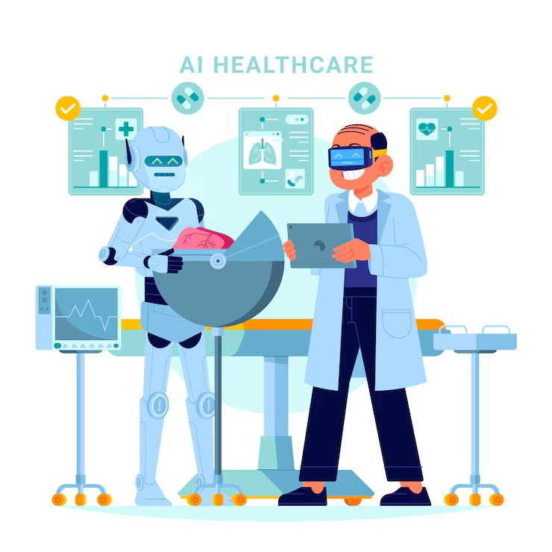
System Architecture
User inputs symptoms (e.g., fever, headache)
Symptoms processed via NLP pipeline
Similarity calculated or ML model predicts disease
Recommended medicine(s) displayed

Slide 8
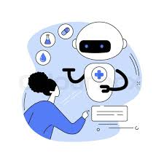
Evaluation Metrics
Accuracy, Precision, Recall (for ML model)
Top-N Recommendation Accuracy (for recommender)
Visual: bar chart or confusion matrix

Slide 9

Results
The model achieved 87% accuracy in recommending the right medicine.
As we give input it will predict disease , give precautions, recommend diet, suggest workout accordingly with the disease.

Slide 10

THANK YOU

